Slide 1
American Energy Market Regulator Outage Report: 2016/2017
Cameron Pollart

Slide 2
Over the 2016 and 2017 calendar years, the AEMR has reported an increasingly large number of outages submitted by the nation’s energy providers. In order to ensure the continued security and reliability of our network, the data team has been tasked with addressing two main areas of concern:
Energy Stability and Market Outages
What are the most common outage types and how long do they tend to last?
How frequently do the outages occur?
Are there any energy providers that have more outages than their peers which may indicate that these providers are unreliable?
Energy Losses and Market Reliability
Of the outage types in 2016 and 2017, what percent were forced outages? In other words, what percent of outages were a result of providers being forced offline?
What was the average duration for a forced outage during both 2016 and 2017? Have we seen an increase in the average duration of forced outages?
Which energy providers tended to be the most unreliable?

Slide 3
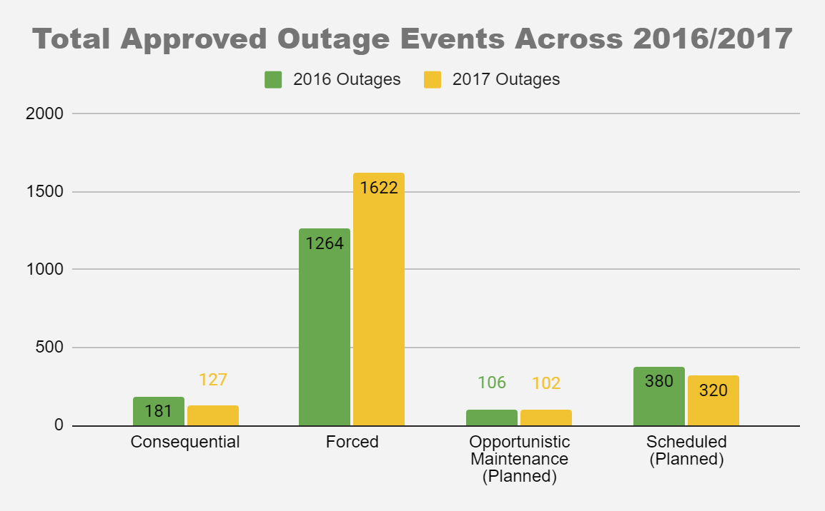
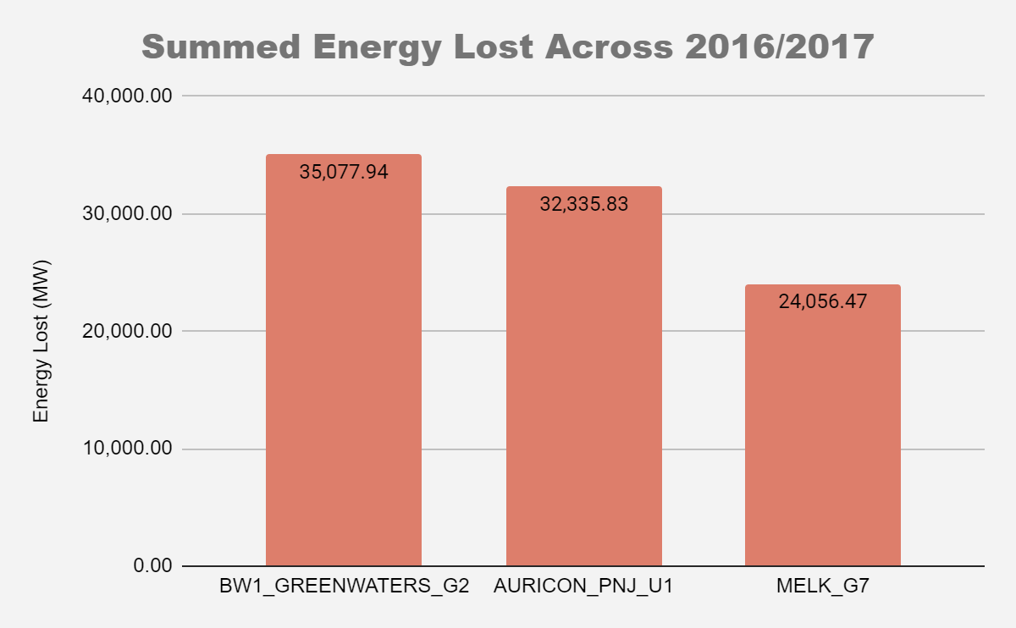
Our analysis reveals that Forced outages were far and away the leading cause of approved outage reports throughout 2016/2017, accounting for 65% and 75% of all outages, respectively. A deeper look reveals Auricon, Melk, and Greenwaters as the energy providers responsible for the most energy loss over these periods, and for whom regulations will need to be better enforced going forward. (Sourced from AEMR Operator Dataset)

Slide 4
In addition to making up most of the total outages, Forced outages also accounted for the 2nd longest average duration (with an increase from 2016 to 2017 these averages combine to 0.68 days), lagging only behind Scheduled outages. The focus for management however should remain on reducing the forced outages, as the scheduled outages are planned well in advance to minimize impact on the network. (Sourced from AEMR Operator Dataset)
Reason | Total_Number_Outage_Events | Average_Outage_Duration_Time_Days | Year
Consequential | 181 | 0.36 | 2016
Forced | 1264 | 0.56 | 2016
Opportunistic Maintenance (Planned) | 106 | 0.32 | 2016
Scheduled (Planned) | 380 | 4.57 | 2016
Consequential | 127 | 0.33 | 2017
Forced | 1622 | 0.79 | 2017
Opportunistic Maintenance (Planned) | 102 | 0.27 | 2017
Scheduled (Planned) | 320 | 5.58 | 2017

Slide 5
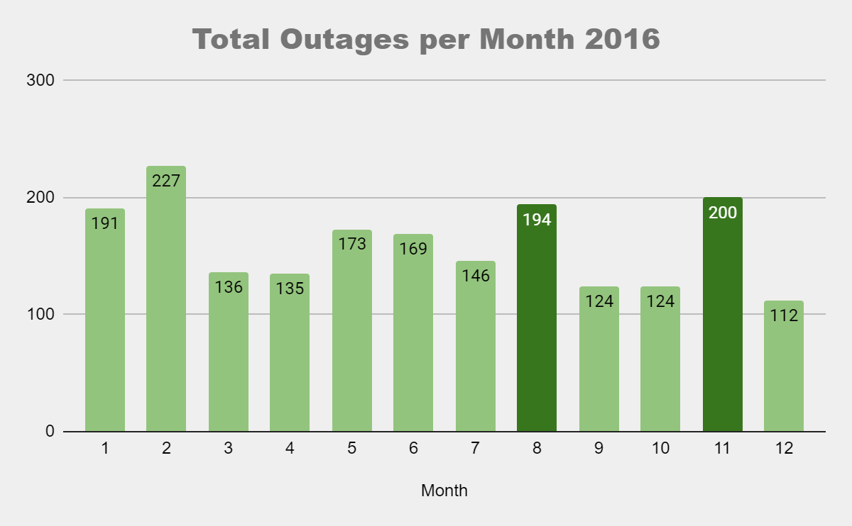
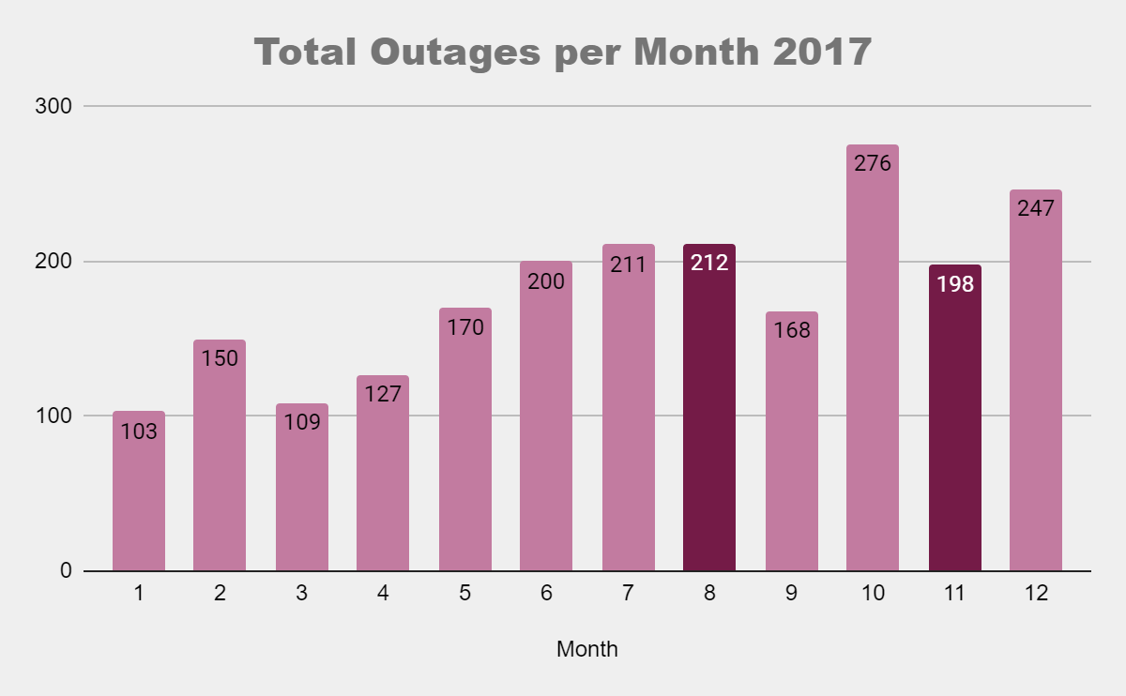
Looking at the frequency of outages on a monthly basis we see a few standouts, particularly with February in 2016 and October in 2017. While difficult to draw strong correlations between the two years, August and November stand out as months with a high number of outage reports across both charts. It’d be advisable to plan for increased outage report frequency during these months moving forward. (Sourced from AEMR Operator Dataset)

Slide 6
As evident from the table, Auricon, Greenwaters (GW), and Melk make up all the top providers reporting outages across both 2016 and 2017. In order to maintain better network reliability, a proper investigation by management into why these key providers have so many forced outages would be recommended. (Sourced from AEMR Operator Dataset)
Total_Number_Outage_Events | Participant_Code | Status | Year
577 | AURICON | Approved | 2017
402 | GW | Approved | 2016
298 | AURICON | Approved | 2016
273 | MELK | Approved | 2016
270 | GW | Approved | 2017
263 | MELK | Approved | 2017
209 | AUXC | Approved | 2016
176 | TRMOS | Approved | 2017
149 | PUG | Approved | 2017
146 | PJRH | Approved | 2017

